Slide 1

Statistics TeamWork
DOMENICO SARCINA
GIUSEPPE NAPOLETANO
VALENTÍN STOYANOV TSVETANOV
ALEX GAYNETDINOV

Slide 2
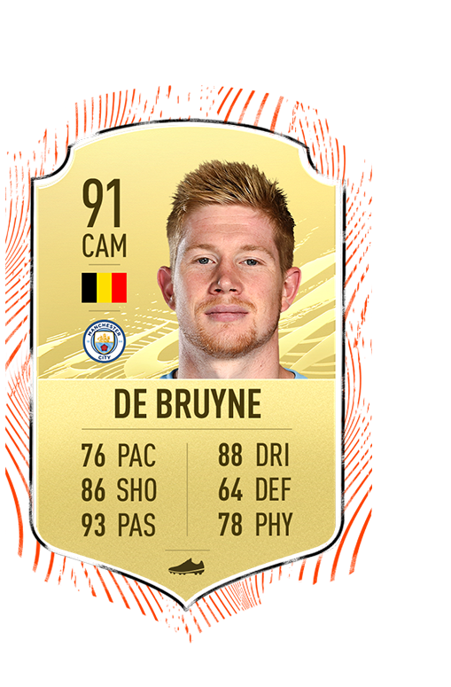
Dataset
About players analytics and stats

Slide 3
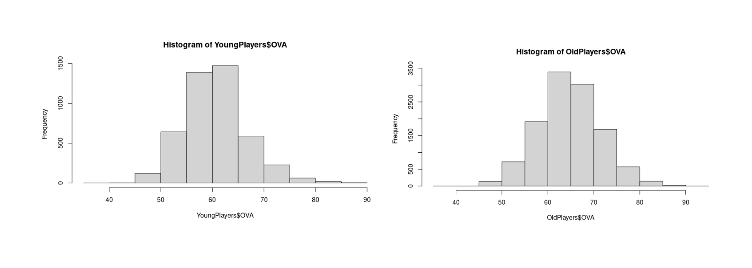
Random Samples
OVERALL DIFFERENCES BETWEEN YOUNG AND OLD PLAYERS

Slide 4
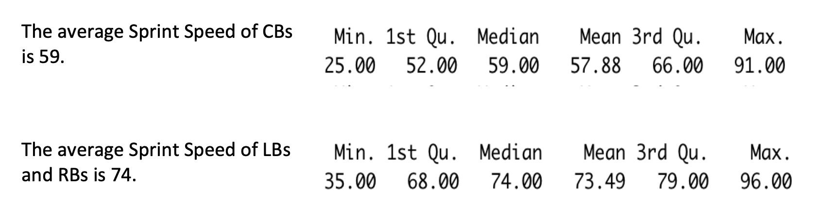
Random Samples - 2
SPEED DIFFERENCES BETWEEN CENTER-BACKS AND LEFT/RIGHT BACKS

Slide 5
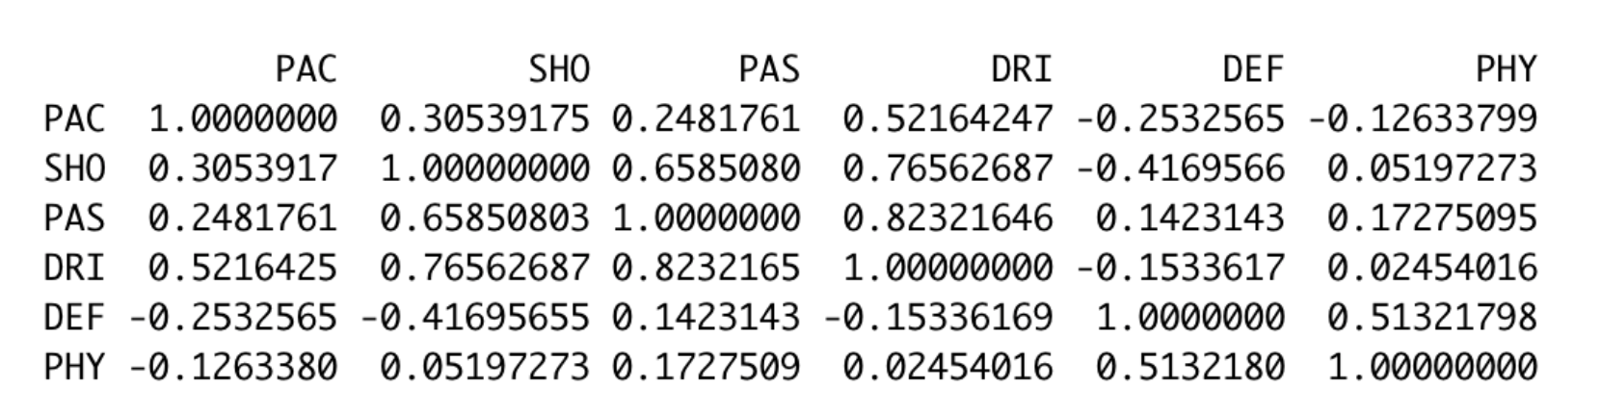
Relation Between Variables
PEARSON’S COEFFICIENT BETWEEN
THE MAIN 6 STATS

Slide 6
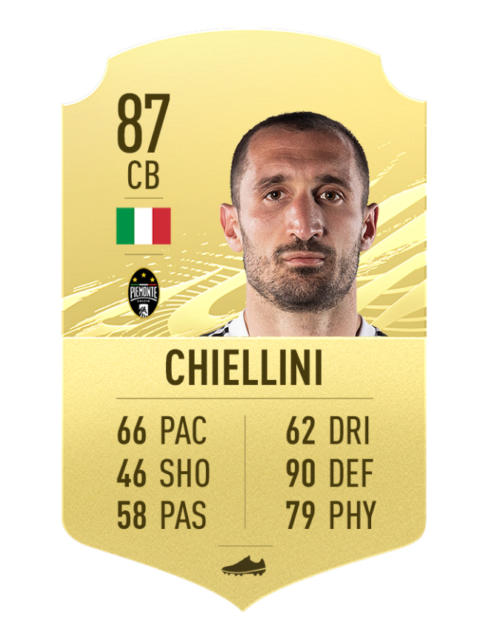
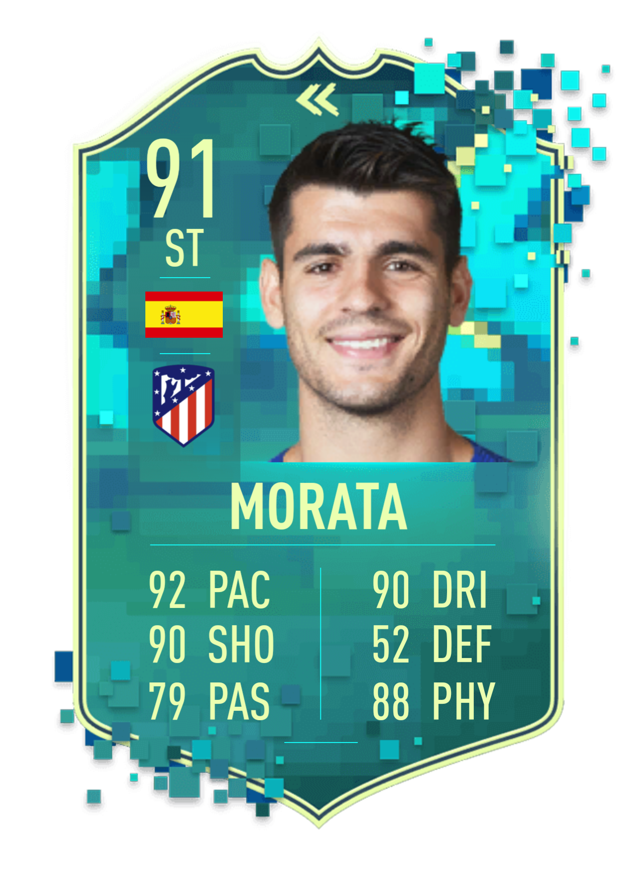
Relation Between Variables
Relation between DEFENDING and SHOOTING is low so players who are defenders or with mostly defensive characteristics imply that they have few shooting stats and viceversa
Correlation between PHYSICAL and DRIBBLING is close to 0 (0.024), so we can affirm that the variables are not correlated

Slide 7
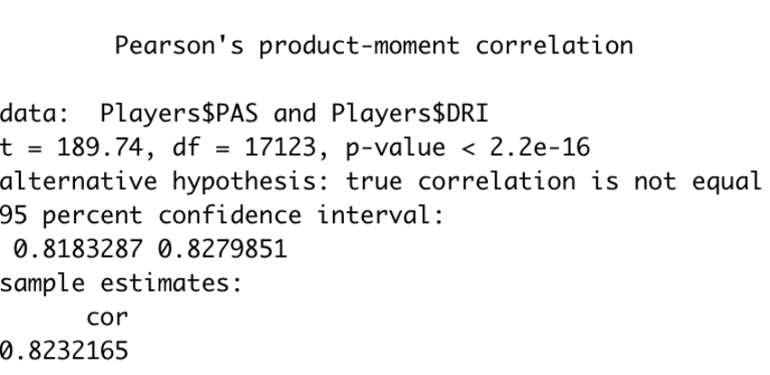
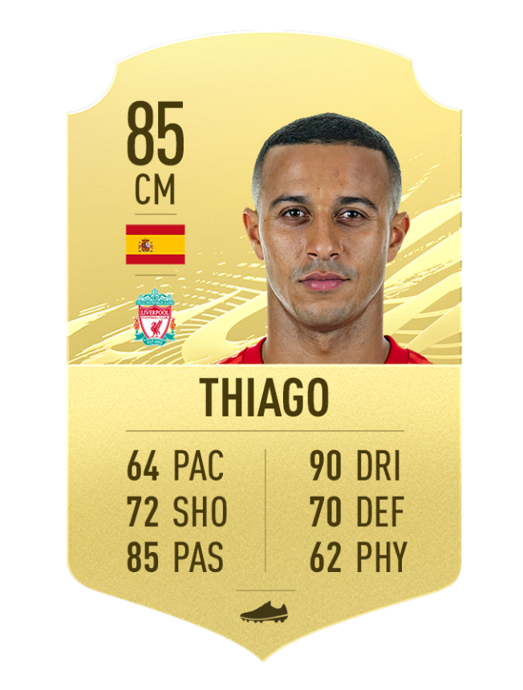
Relation Between Variables
Players who have mostly PASSING characteristics imply that they have high characteristics about DRIBBLING and viceversa

Slide 8
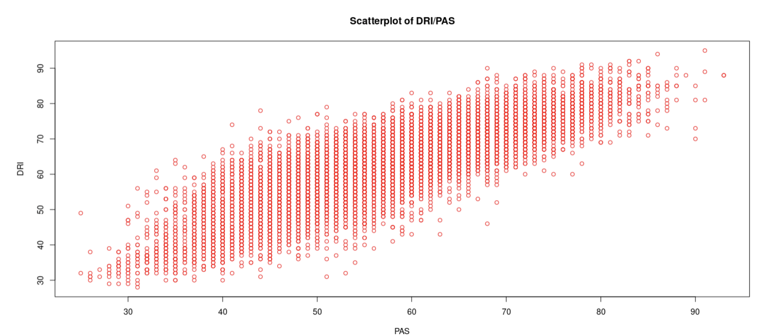
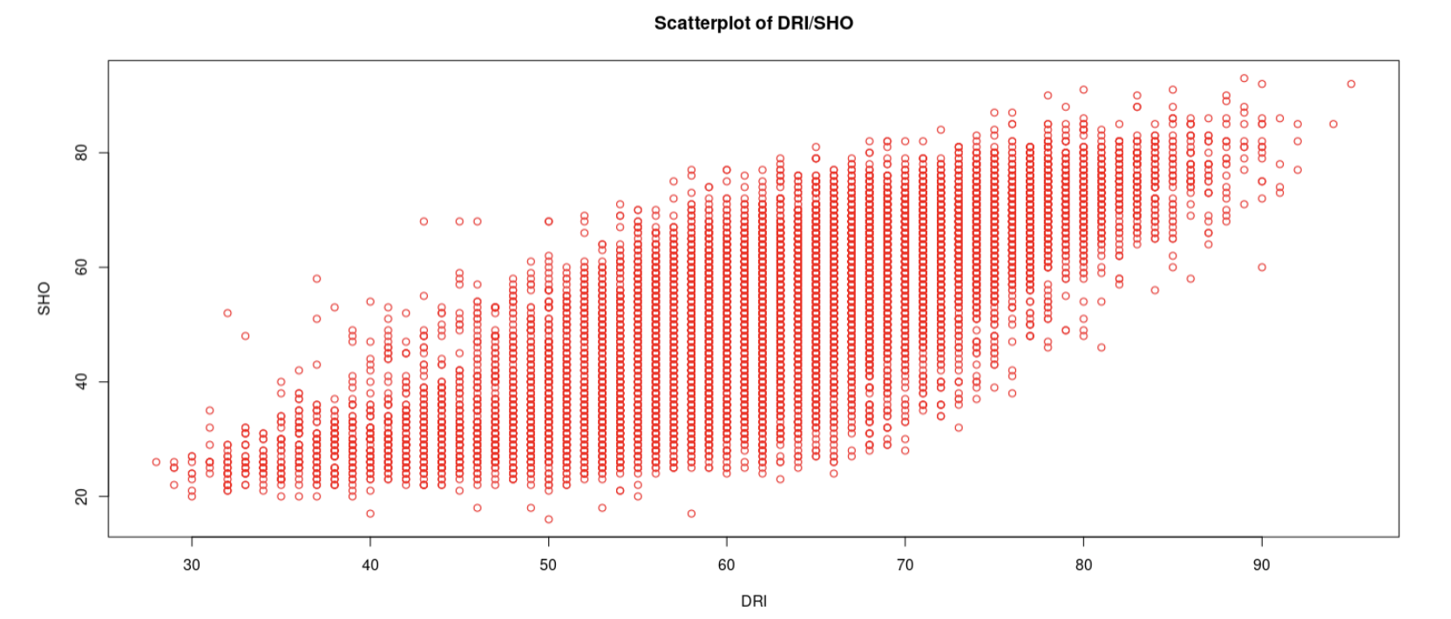
Regression Model
Both variables may have a direct relationship because whenever “x” grows, “y” also does it and vice versa

Slide 9
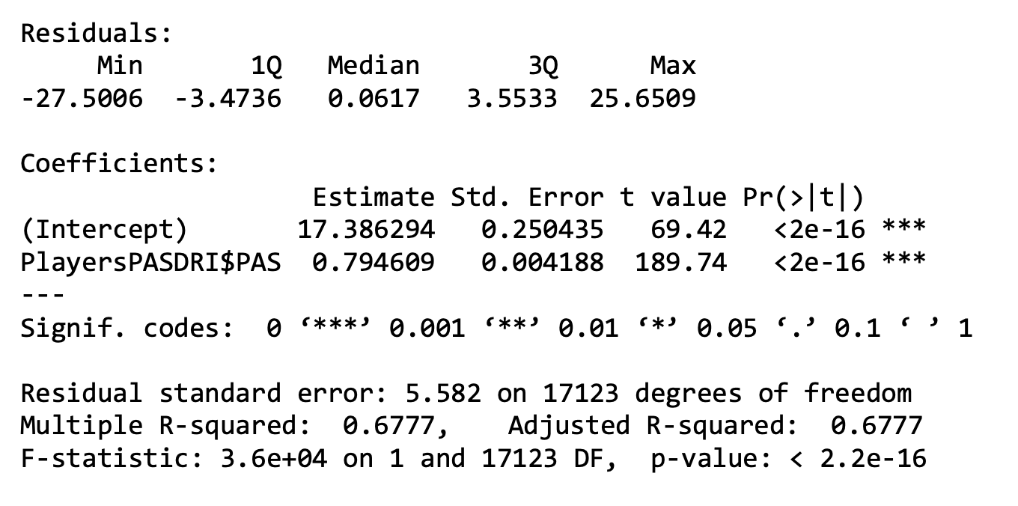
Linear Model
There is a relation between the variables, because the coefficient t value is far away from 0 and a small p-value for the intercept and the slope indicates that we can reject the null hypothesis

Slide 10
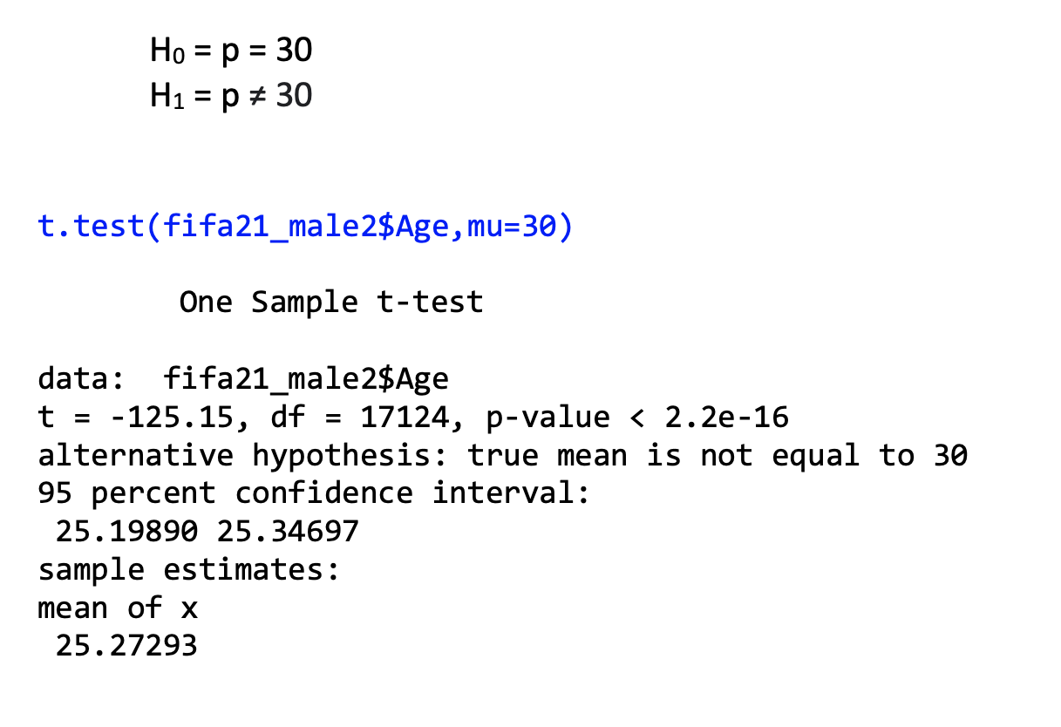
Inference Statistics – Hypothesis 1
We want to test If the mean of the age of the players is 30

Slide 11
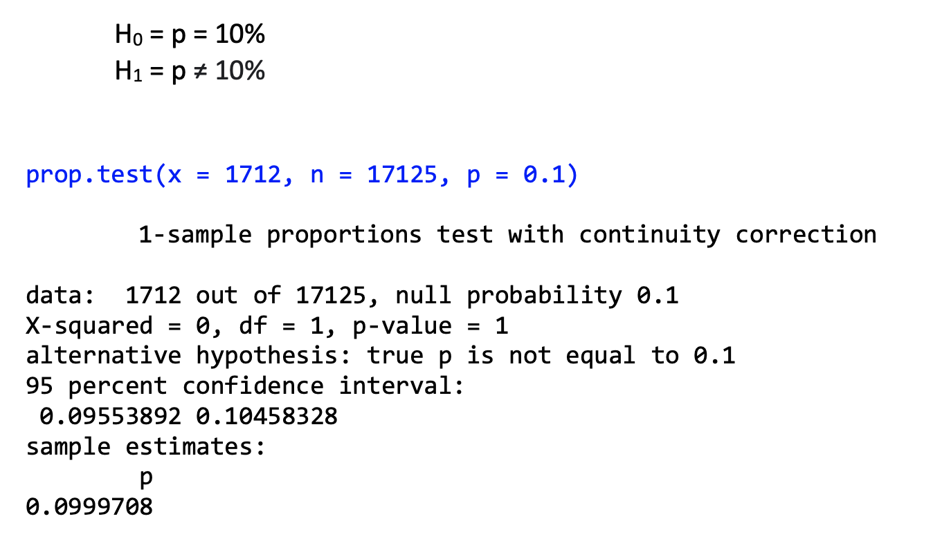
Inference Statistics – Hypothesis 2
10% of the players have English nationality, 7% are Germans and the remaining 83% have other nationalities. So we have 17,125 players, 10% percent of that are English (1712)

Slide 12
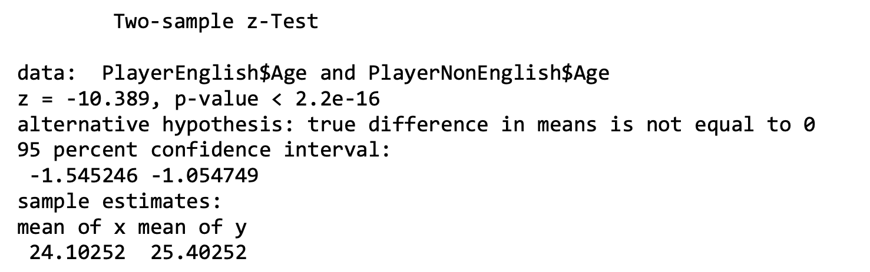
Inference Statistics – Hypothesis 3
We want to test if the mean of the players age which are English and non-English are the same

Slide 13

Any questions?

